Slide 1


BETTER TEAMS
Achieve BETTER RESULTS
Introduction to
Performance Management

Slide 2

About Performance Culture
We are a Performance Management Solution that improves how Managers lead and coach their team.
We love helping others maximize their potential and build great cultures.
Our solution is delivered through Training and our Web-based application.

Slide 3

Employee Engagement is a Reflection of an Organization’s Culture
A
Vision
Shared by All
A
Mission
to Believe
In
Awesome
Managers
Attributes
of a
Great Culture
Trust
Accountability
Notes:
Vision – Everyone is on the same page.
Mission – Understand “WHY” employees should work there and “WHY” customers buy from them.
Trust – Enables risk taking and fosters team chemistry
Accountability – Employees are not only accountable to themselves but also their team.
AND the KEY to making this happen is having AWESOME Managers.

Slide 4
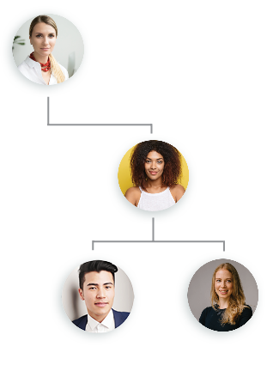
#1 Driver for Employee Engagement?
The Manager & Employee Relationship
In most cases, people leave their bosses, not their company.

Slide 5


Helping Managers become better Coaches and Leaders
Great Managers don’t focus on one dimensional results (i.e., Performance Metrics).
Great Managers coach and develop their employees.
This means focusing on the organization’s Behaviors & Core Values as well.
Notes:
Great Mgrs don’t just focus on Performance
They also coach and develop their employees by focusing on Business Behaviors and Core Values that drive performance and team chemistry.
That’s why we use the Performance Values Matrix.
Performance Culture’s goal is to help every employee be great, to be a star by not only meeting and exceeding POs but also displaying behaviors that reflect your Core Values.

Slide 6

Our “Why & What”
What is changing?

Slide 7
But first the history…
Prior to February 2019 there was not a formal performance review process
  Some departments did them while others didn’t use a review process
  Departments created their own review forms
  Some departments would give straight across the board increases (everyone gets 2%) while others differentiated based on performance (even without a review)
The Performance Culture system purchased/implemented in 2019 because
they focus on coaching with a simple to use software.
  Only administrative staff and non-exempt non-union staff
  Faculty have their own review process; Any type of formal review for unions would have to be negotiated for in the collective bargaining process
  Former VPHR Husted worked with a consultant, formed focus groups to develop the Behaviors and Competencies that are now used as the basis of the performance review

Slide 8
Why are we enhancing Performance Culture?
The goal of performance management is to provide clarity around strategies and goals, provide continuous feedback and assist in employee development and engagement
Intended results: high-performing teams focused on our strategic initiatives and identifying top talent
We are rolling out a ‘new’ feature for managers and employees – Goals
We will offer two virtual manager (has direct reports) trainings and two virtual employee (individual contributor) trainings
We will reinforce the importance of check-ins
Notes:
Considering answering how this will be different from your current process (paper to online, annual to quarterly, etc.)

Slide 9
What’s in it for you?
Our goal is for you to have more authentic and candid conversations with your manager on how you can thrive in your role, have a clear line of sight to the University Strategic Pillars, divisional and department goals, while understanding how your contributions align with the parent strategies.
You will be able to identify your own goals and track goals throughout the year.
Provides opportunity for interactive dialogue about your professional goals

Slide 10
Performance Culture 2.0 –
Goals and Check-Ins

Slide 11
Check-Ins
Quarterly Check-Ins
  Staff member should check-in every quarter.
  Manager receives an email from Performance Culture when employee completes check-in
  Manager must schedule a 15–20-minute discussion to review check-in response with the employee
  System will send employee a reminder when the next quarterly is due
  HR recommends using Outlook as well for scheduling the check-ins
New Employees
  Manager will assign the Check-In template in Performance Culture when a new administrative employee is hired.
  Manager must review Performance Culture and how to do a check-in with new employee,

Slide 12
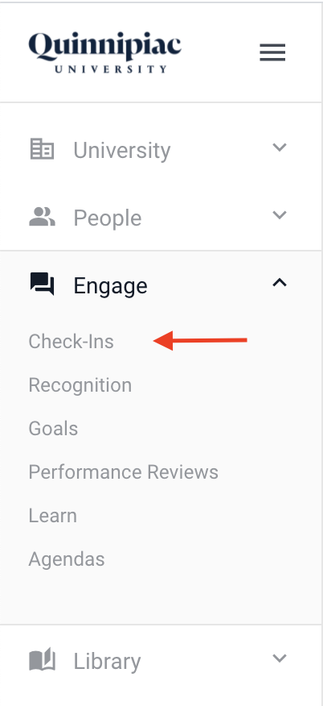
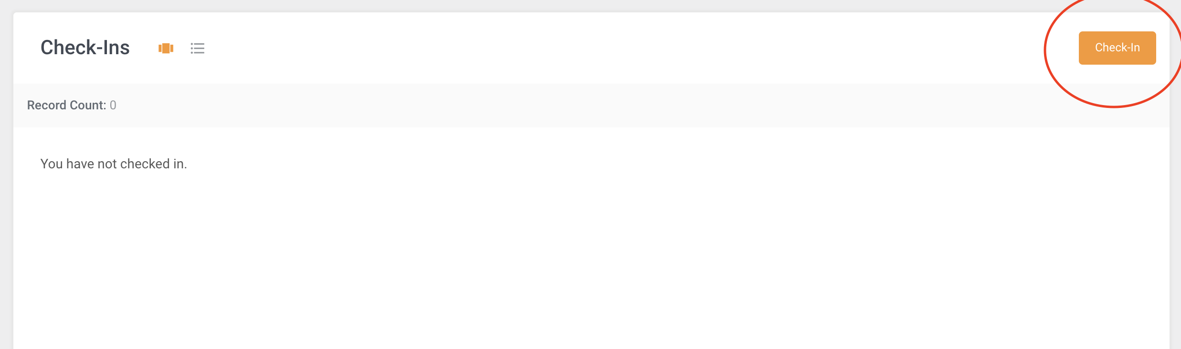
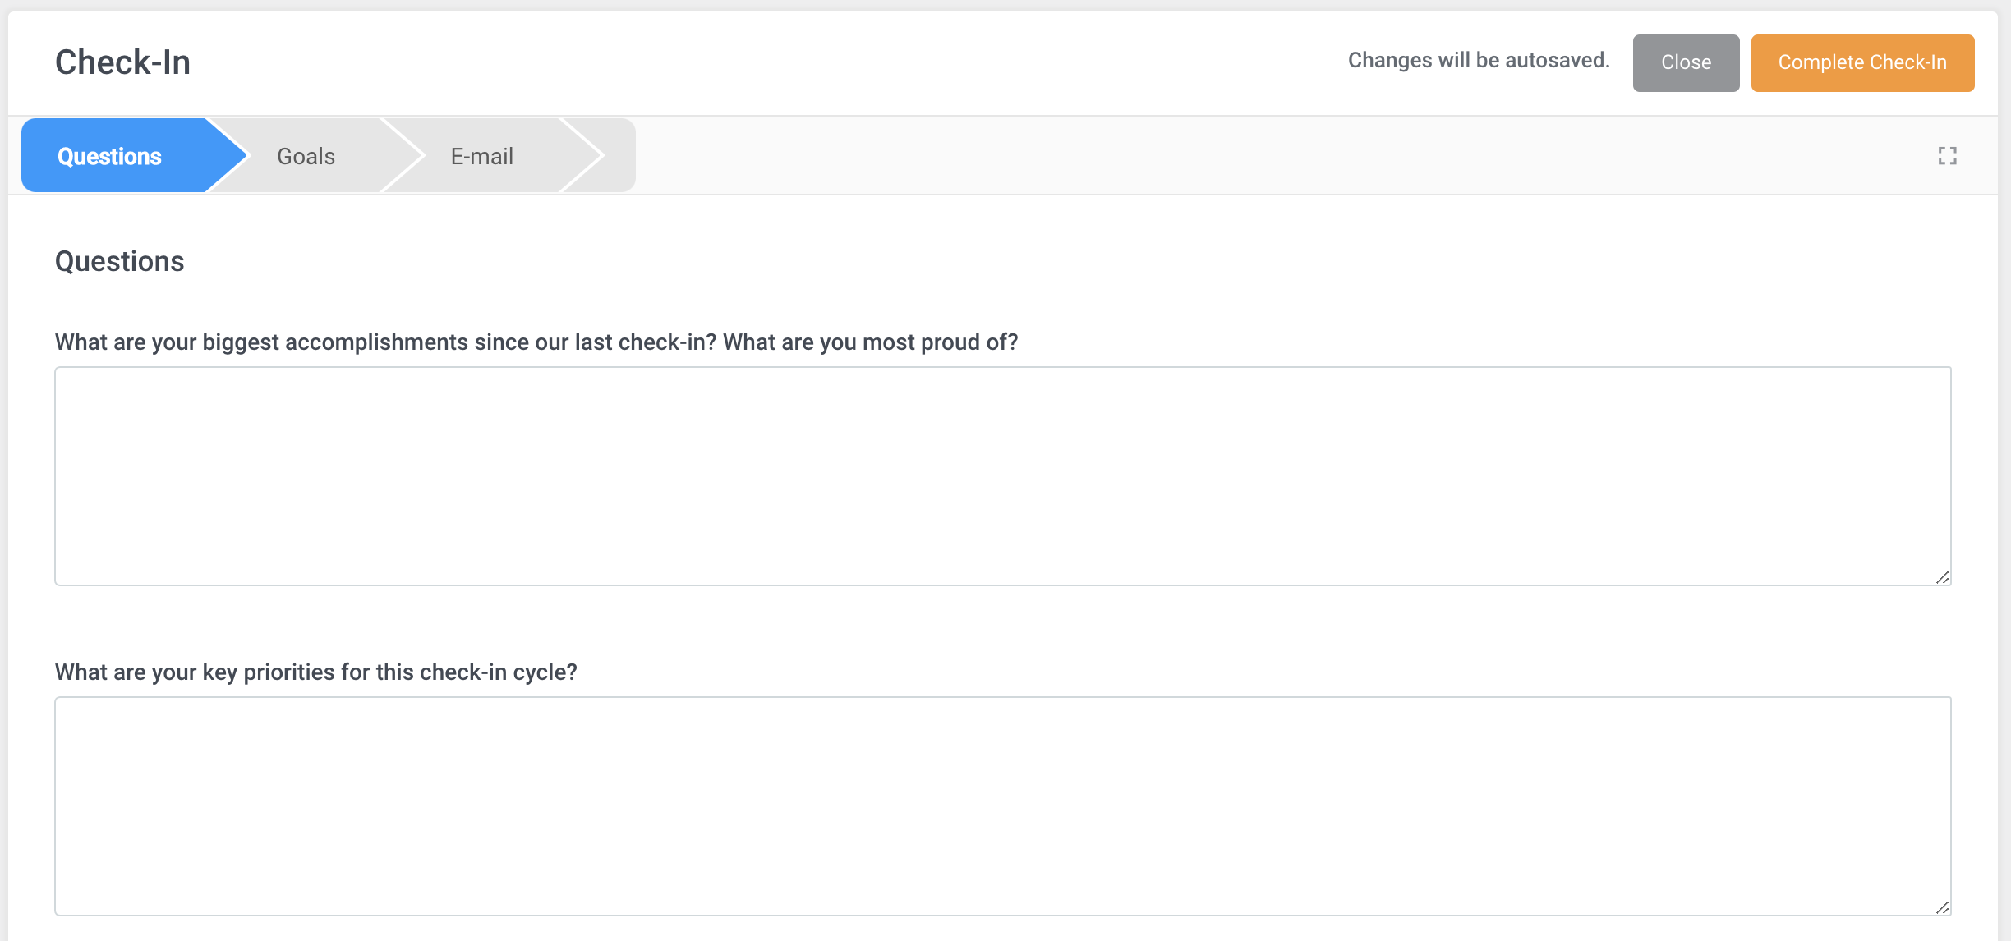
Checking-In

Slide 13
New Feature - Goals
Goals – 3 Cascading Levels
  Strategy – Align to Strategic Pillars (attachment under University>Documents)
    MC level strategies will be cascaded through the division by adding contributors.
  Department – managers will enter goals, align with a strategy and can add contributors
  Individual – employees may enter their goals and align to a department goal
Managers must schedule meetings to discuss goals with their direct reports.
  Employees (Individual) will enter their goals, align to the parent strategy
  Managers will add contributors to their goal as applicable
Communication is key!

Slide 14
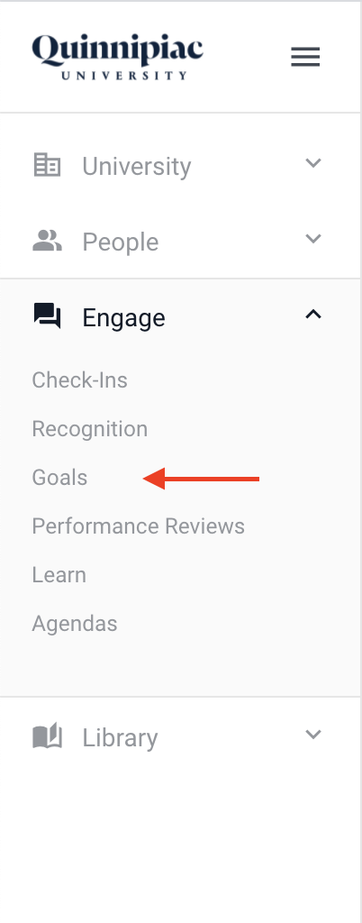
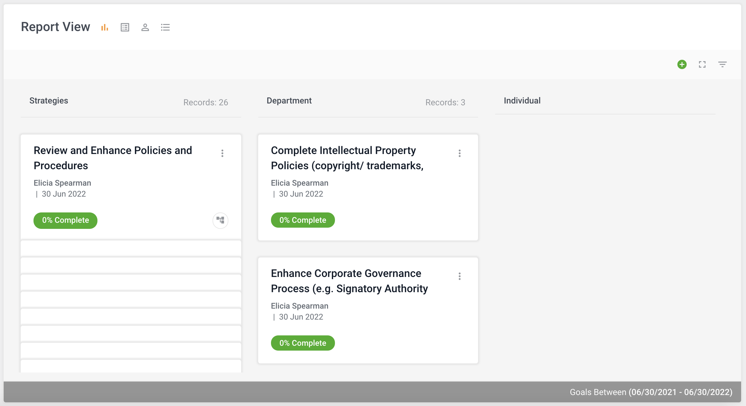
Goals

Slide 15
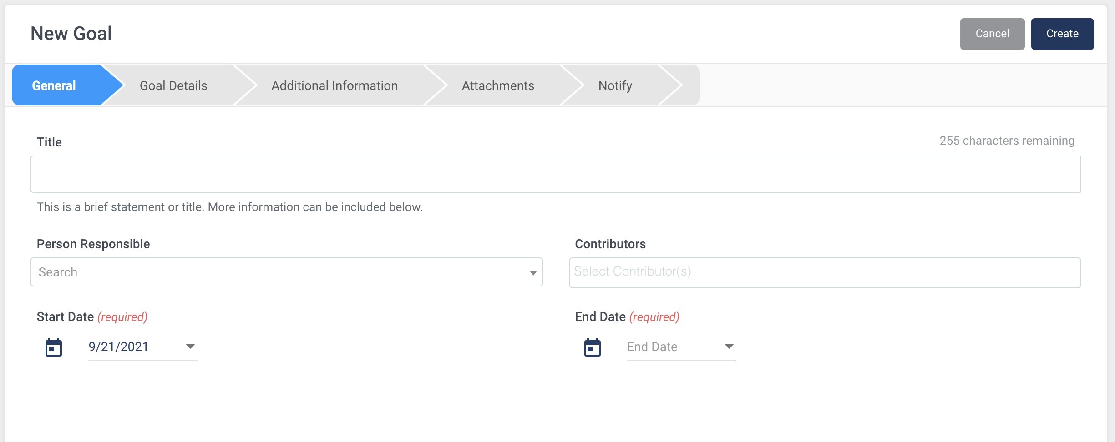
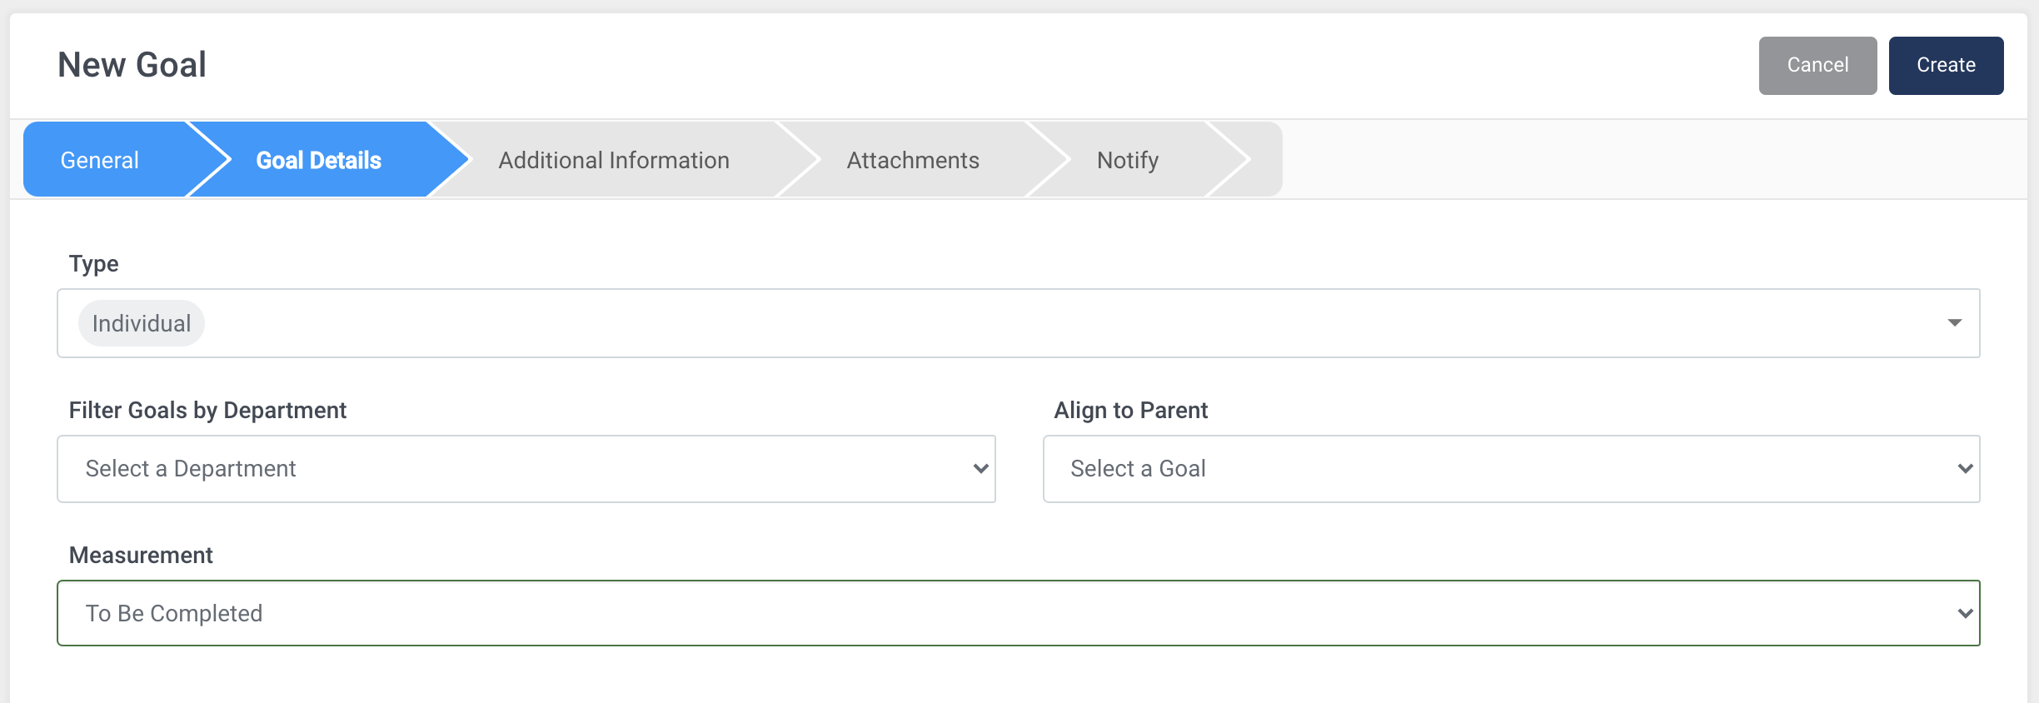
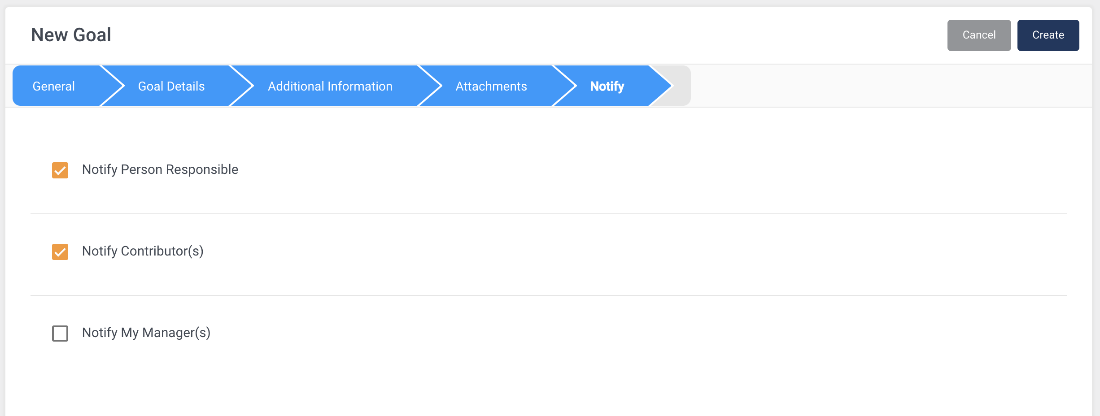

Slide 16

Communication is KEY!!!
Managers must schedule time to discuss Strategy, Department and Individual goals.
Entering goals into Performance Culture helps track the them but the interactive dialogue is the key ingredient to engaging and motivating employees.

Slide 17
How will you be impacted?
We are going to do a better job of setting clear expectations upfront and give you the opportunity to provide feedback to your managers.
Tracking your goals will facilitate completing the self-assessment letting us know how you feel you performed.

Slide 18
How will you get the knowledge, skills and information you need?
Performance Culture includes video tutorials with both system and coach training. Coaching resources and help videos are also included within the software.
Performance Culture Learn Library
Live chat feature available Monday - Friday

Slide 19
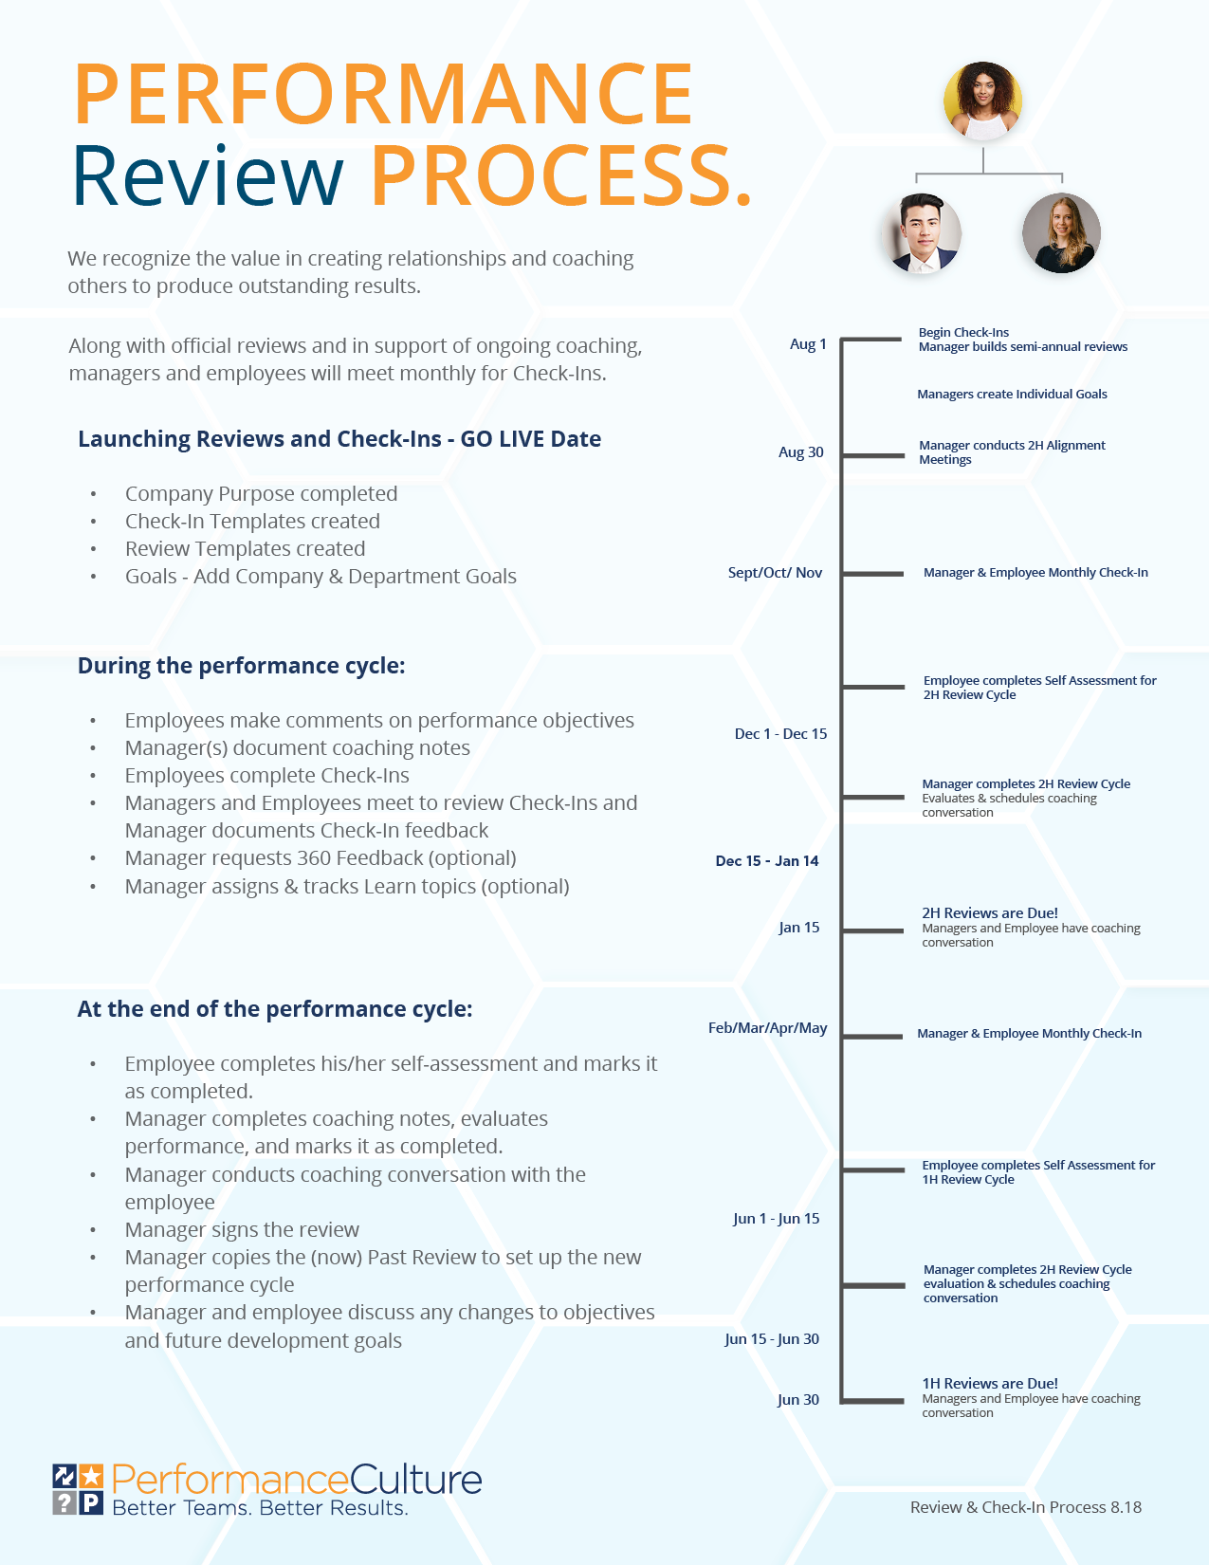
Performance Culture Timeline
Manager Training 1 - Sept. 30th, 9-10:30am
Employee Training 1 - Sept. 30th, 11-12pm
Manager Training 2 – Oct. 5th, 9:30-11am
Employee Training 2 – Oct. 5th, 2-3pm
Meet with Direct Reports to discuss their Departmental Goals – Oct. 15th
All Leadership Council Members and Direct Reports enter Goals - Oct. 22nd
Manager/Employee Check-Ins
1st Check-In - Nov 19th
2nd Check-In - March 8th
Performance Reviews
Employee Self-Assessment - May 6th
Manager Assessment - May 27th
Employee/Manager Performance Review Conversations - June 17th
Notes:
Use this slide to talk about your roll-out timeline.
Considering answering the following:
When will they gain access to the system.
When will your team be rolling this out to everyone.
When should they expect to be having the initial conversations about expectations with their team.
When will they expect to have the first review coaching conversation. (Will you be using Quarterly, Semi-Annual, or Annual review cycle)
And any other questions you feel appropriate. Also handout a timeline if you have customized one. The image is a sample.

